Slide 1
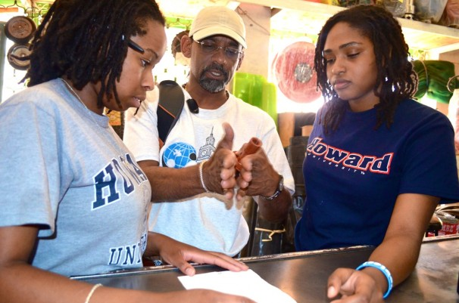
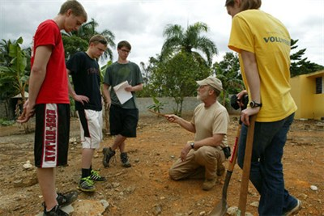
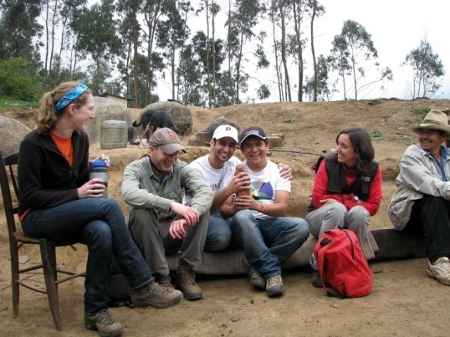
Developing Mentors and Mentor Relationships

Slide 2
Objectives
Brief explanation and definition of mentor
Discuss rewards and challenges mentors face
Do’s and Don’ts for mentors
Perspectives from students and mentors
Resources and Questions

Slide 3
Role of the Mentor: Defined
Responsible Engineer in Charge (REIC): Responsible for over sight of design, EWB-USA project compliance, and student learning (404- Mentor Statement of Intent).
Professional Mentor Team: Shall enable the transfer of engineering knowledge to all parties, have the capacity for cross cultural communication, ability to work well with diverse groups, understand the fundamentals of the EWB-USA model of development, and numerous other attributes (405- Professional Mentor Teams and Qualifications).

Slide 4
Role of the Mentor: Defined
PROJECT LEVEL | IMPACT OF FAILURE | REQUIRED RESPONSIBLE ENGINEER IN CHARGE QUALIFICATIONS | EXAMPLES
LEVEL 1 | Failure of the project may result in death, severe illness, injury, or significant damage of property. | Licensed Engineer with at least 7 years of direct experience in design and construction of infrastructure similar to that proposed in the project. Each mentor is subject to approval by EWB-USA project managers. | Most construction projects including buildings and bridges and large-scale water projects.
LEVEL 2 | Failure of the project would not result in death, severe illness, or injury. However, some damage to property is possible. | Professional with at least 5 years of direct professional experience (post bachelor’s degree) in design and construction of infrastructure similar to that proposed in the project. Each mentor is subject to approval by EWB-USA project managers. | Water supply, water treatment, sanitation, and energy projects.
LEVEL 3 | Failure of project would not result in significant damage beyond limited economic loss. | Professional with 3 years of direct professional experience in design and construction of infrastructure similar to that proposed in the project. Each mentor is subject to approval by EWB-USA project managers. | Agriculture, improved stoves, computer systems, and other similar projects.

Slide 5
Role of the Mentor: Defined
Qualifications are evaluated on project by project basis
Design experience in the technology that the project is using. One qualified mentor must travel on each trip.
Construction experience that is relevant for the project at hand. Equivalent of two years construction experience
International development relevant to work EWB-USA does. Equivalent of 2 full-time years with 3 months of in-country work.

Slide 6
Role of the Mentor: Liability
EWB-USA carries “errors and omissions” insurance to protect Mentors from professional liability.
EWB-USA also carries commercial general liability insurance that covers Mentors and other EWB-USA members traveling on trips.
Only for EWB-USA members who are approved for travel on approved trips.

Slide 7
Role of the Advisor: Un-Defined
All student chapters must have a faculty advisor to help guide the overall functionality of the chapter
Faculty advisors should be an advocate for the student chapter in a university setting and engaging with university personnel
Depending on the project requirements the faculty advisor can serve on the Mentor Team

Slide 8
Role of the Advisor: Un-Defined
Depth of involvement by the advisor varies greatly between chapter. Not controlled by EWB-USA
Students and advisor should discuss roles and responsibilities upfront
Chapters must engage advisor to keep them up to date on chapter
If possible keep two faculty members involved instead of one solo advisor
Chapter advisors have a great impact on the chapter as a whole and on the student/mentor relationship

Slide 9
The Importance of this Relationship
Strong Programs
EWB-USA project model dependent on working relationship between the mentor and student groups
Responsible Leaders
Instill critical thinking, teach to recognize problems or address concerns before moving forward in the project process
Develop Partnerships
Most issues are a result of miscommunication or not having a clear expectations from the beginning

Slide 10
Developing perspective: what mentors SAY & What Students SAY

Slide 11
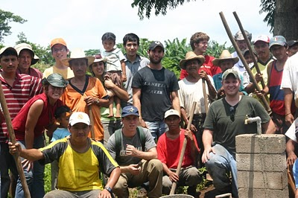
Mentors Say: It’s awesome to be a mentor because…
Engaged in work that allows you to be part of the design and construction, involved in the whole process, start to finish
The professional & personal growth you will observe in your teammates as well as in yourself will rock your world
Develop your own skills and awareness - learn in the process

Slide 12
Mentors Say: It’s awesome to be a mentor because…
Opportunity to impact the next generation of engineers (potential future employees!)
Observe dual success, communities working together to achieve goals and students growth
Enthusiasm is contagious and the passion of those around you will humble you.

Slide 13
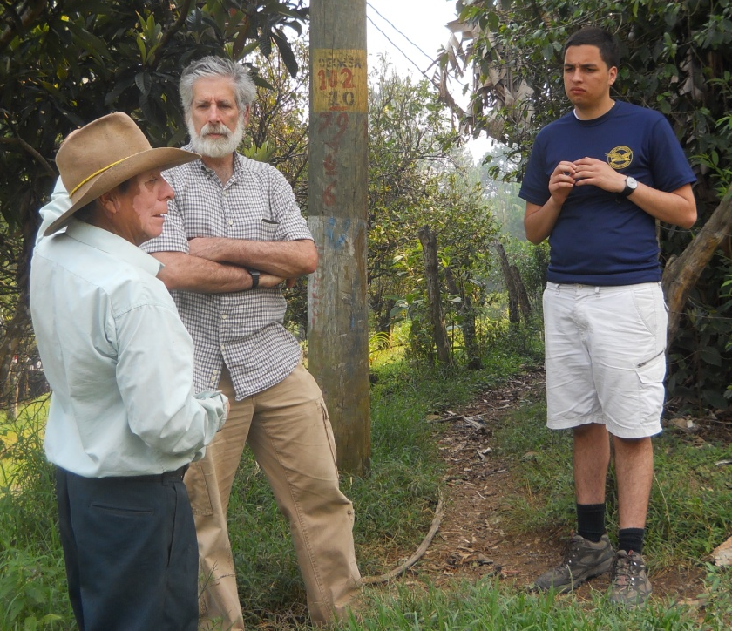
Mentors Say: It can be challenging because…
High student turnover, frequent changes in leadership and loss of project path
Harness enthusiasm and accept chaos
Range of experience- dealing with freshman to grad students
We don’t have all the answers! Limited technical knowledge or “in-country” skills

Slide 14
Mentors Say: It can be challenging because…
Not physically there, whether you are in the same city or 2,000 miles away
“Awkward Authority” – not faculty, can’t give grades, but you are responsible for their work
Different generations, demands, ways of communicating
Mentors don’t work on campus and aren’t a part of the daily EWB conversation
Difficult to let them make mistakes

Slide 15
Common Gripes from Student Groups
GRIPES | SOLUTIONS
Mentor acts without student group approval | Address it directly with the mentor, with goal of finding common ground.
Mentors are too hands off, not giving enough direction | Jointly determine the level of interaction required by all members of the team and by project type from the start.
Mentor makes unreasonable demands about travel, review timelines, funded expenses, etc. | All new project/mentor teams Agreement of Understanding defining all responsibilities
Mentor is inconsistent about meeting times and communication | Set standard meeting times and agreement to define roles and expectations

Slide 16
Common Gripes from Mentors
GRIPES | SOLUTIONS
Student group does not communicate deadlines and milestones until last minute | Be proactive at the beginning of each semester to get information on upcoming milestones, travel, reports
Students don’t act on what we know is good advice | Always explain the ‘why’ behind advice
Students take our time for granted | Explain mentoring is a professional relationship with professional boundaries.
Internal communication within the student chapter is ineffective | Designate points of contact and always discuss concerns with chapter administration

Slide 17
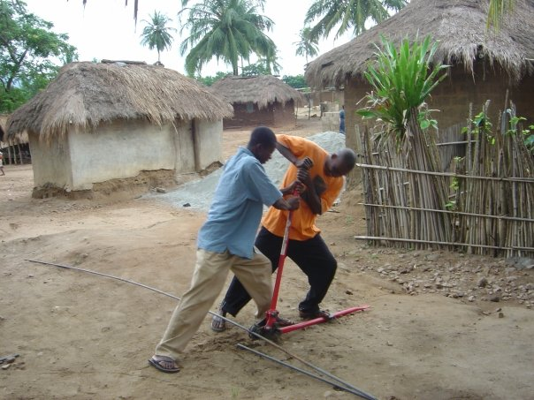
MENTORS’ DOS AND DON’TS

Slide 18
What a strong mentor does NOT do
Write reports
Develop or select design
Act without approval
Ignore warning signs
Develop separate plans
Oppose the group, except in extreme circumstances
Argue, cause drama or conflict
Disparage to EWB-USA, disparage to the host community
Dictate orders
Demand

Slide 19
What it means to be a Strong Mentor
Oversee, Support, Guide, Listen, Discuss, FACILITATE
Effectively communicate
Example of professionalism
Provide resources
Knowledgeable about EWB-USA organization and project process
Attend meetings and presentations
Provide feedback on design and reports
Share real world experience
Help with scoping, budgeting, and milestone tracking
Provide safety net
Let them make valuable mistakes when possible
Intervene, when necessary
Foster leadership
Participate in TAC calls
Be prepared to cover some or all travel expenses for self
Lead by example, including getting hands dirty
Teach them “how to fish” and get out of the way

Slide 20
Student Perspective: What they want in a mentor
Project management guidance
Help develop design alternatives
Be a voice of support and advocate
Timely feedback
Provide constructive criticism
Be passionate about the project!
Have patience with the students
Encourage and push students beyond what they think they can do to become a better engineer, thinker, and traveler

Slide 21
Professional Perspective: What they want in a student group
Effective and efficient communication
Don’t want to answer the same question multiple times
Unless we say its OK, don’t call us at 10PM (or 2AM)
Deadlines and project schedules!
All milestones and expectations need to be communicated from the start
Professionalism
The chapter/mentor relationship is a professional relationship
Respectful of mentors time and schedule

Slide 22
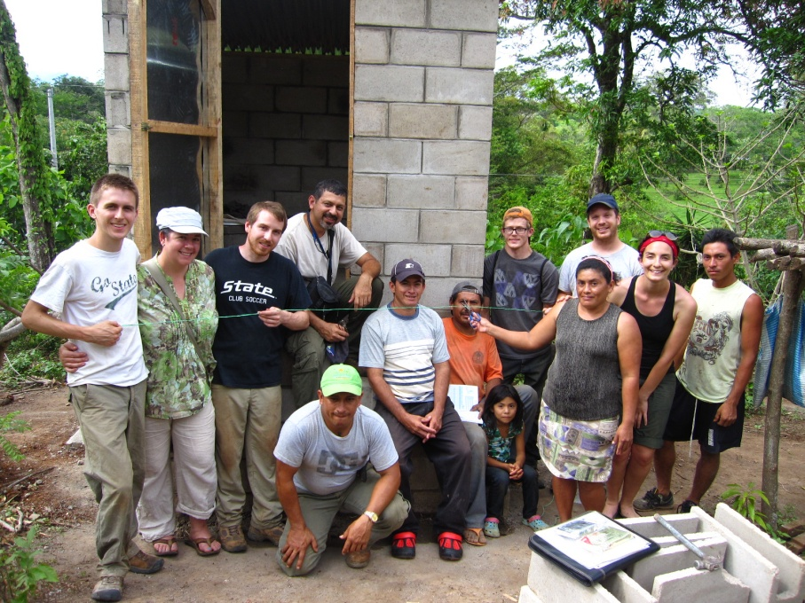
Mentor / Project Team Relationship: When it all Goes Right!
Work together as a team
Share same expectations and collaborate on decisions
Strong communication
Willing to give and receive honest feedback
Learn from mistakes
Establish trust and rapport, form friendships
Help students transition from 16+ years of learning and being lectured to using that knowledge and becoming productive part of workforce

Slide 23
Resources for Mentoring
Review the resources available on the EWB-USA member pages
#405 Mentor Qualifications and
#404 Mentor Statement of Intent are listed under Sourcebook Downloads
Watch EWB-USA Webinar on Professional Mentors and Technical Leads Role in EWB-USA
Member Log-in EWB-USA → WEBINARS
Visit the EWB-USA Mentor Committee website!
http://ewb-mentors.org/ contains many resources:
Mentor Coordination Database
Use this tool to network between mentors and students
We have 830+ profiles of students and mentors!
If you have an existing profile on the database, please update it!
The Unofficial Guide to Mentoring
EWB-USA Mentor Program Overview
Chapter/Mentor Memorandum of Understanding

Slide 24
Questions?
Joe Elsinger
EWB-USA Mentor Committee Chair
ewbmentor@gmail.com

